Slide 1
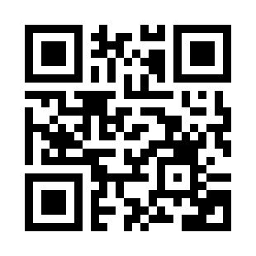

Software Quality Management Quiz
https://bit.ly/3St1din

